Slide 1
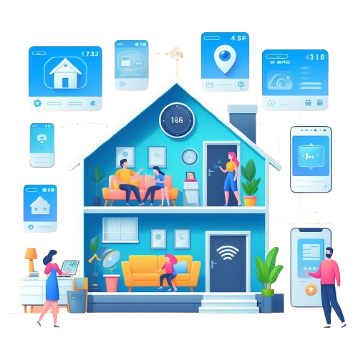

SmartSage: IoT-Driven Home Automation with Predictive Machine Learning
Course Teacher:
Dr. Khondaker Abdullah -Al-Mamun
Professor , Dept. of CSE
Presented By:
Rayhan Al Shorif – 0122410022
Dept. of CSE
United International University (UIU), Dhaka, Bangladesh.
Page No: 01

Slide 2
Motivations
Convenience
Convenience
To make a Comfort Zone
Security & Safety
Accessibility
Tech Savvy Life style
United International University (UIU), Dhaka, Bangladesh.
Page No: 04

Slide 3
Related Works
S. Mahmud, S. Ahmed, and K. Shikder [ 1 ] developed a smart low cost home automation system with a metering system using IOT for user-controlled and monitored electronic devices.
A portable, low-cost, and user-friendly IOT-based home automation system was proposed by Jabbar, W. A., Kian, T. K., Ramli, R. M., Zubir, S. N., Zamrizaman, N. S. M., Balfaqih, M., Alharbi, S [2]
An android application was connected with the control system through Wi-Fi across a cloud network. To fight the rising costs of electricity bills and the scarcity of resources type of system was implemented by T. Dhanush, B. Aswin Ramnath, M. Krishnakanth, and N. Bhalaji [3]
United International University (UIU), Dhaka, Bangladesh.
Page No: 04

Slide 4
References
[ 1 ] Mahmud, S., Ahmed, S. and Shikder, K., 2019, January. A smart home automation and metering system using internet of things (IoT). In 2019 International Conference on Robotics, Electrical and Signal Processing Techniques (ICREST) (pp. 451-454). IEEE.
[ 2 ] Jabbar, W.A., Kian, T.K., Ramli, R.M., Zubir, S.N., Zamrizaman, N.S., Balfaqih, M., Shepelev, V. and Alharbi, S., 2019. Design and fabrication of smart home with Internet of Things enabled automation system. IEEE Access, 7, pp.144059-144074.
[ 3 ] Dhanush, T., Ramnath, B.A., Krishnakanth, M. and Bhalaji, N., 2018, July. Smart Rooms Automation System by Thermal Sensing. In 2018 International Conference on Inventive Research in Computing Applications (ICIRCA) (pp. 596-600). IEEE.
United International University (UIU), Dhaka, Bangladesh.
Page No: 05

Slide 5
Thanks
United International University (UIU), Dhaka, Bangladesh.
Page No: 06

